Slide 1
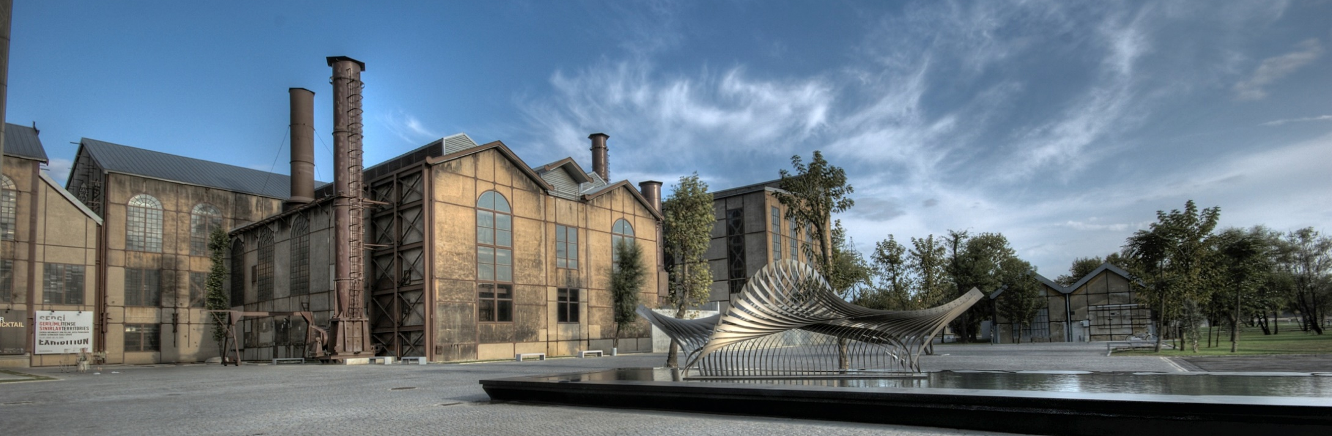
BİLGİ HelpDesk – Ticket System

Slide 2
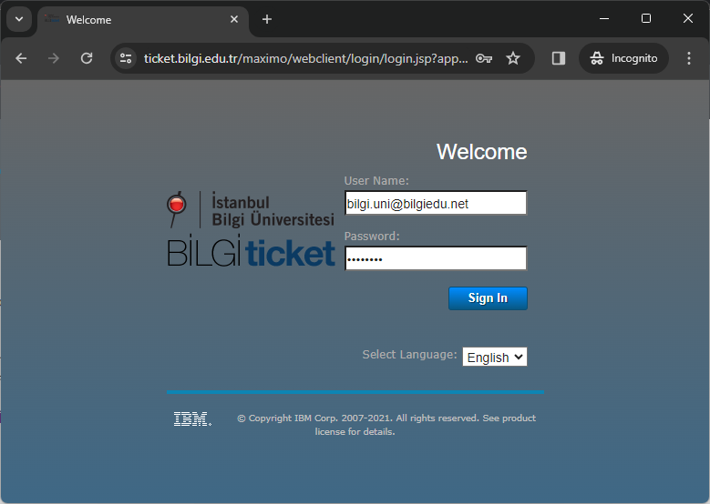
Access to Ticket System
Go to https://ticket.bilgi.edu.tr and log in with your BİLGİ username and password.

Slide 3
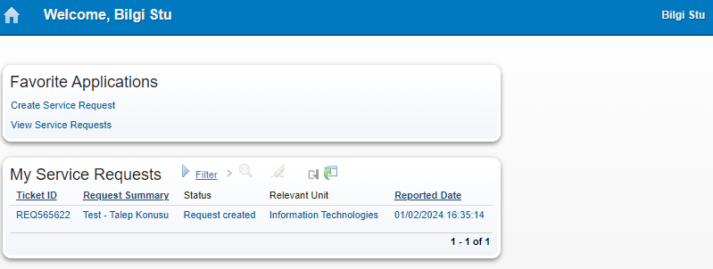
Ticket System Home Page
On the start page that opens;
you can create a new request, view your previous requests, and access the details by clicking on the relevant request.

Slide 4
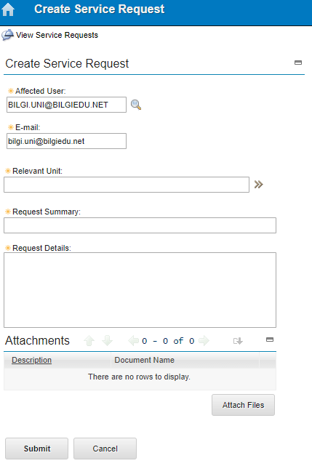
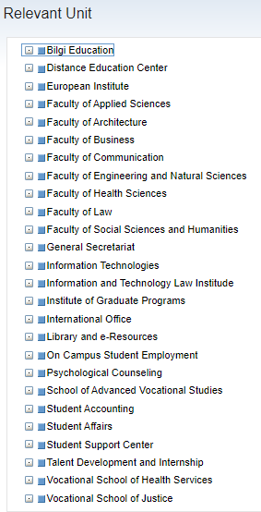
Creating New Request
On the create service request screen;
The Request Owner field is automatically filled with the user name signing into the application. If the request will be opened for a different user, it can be selected from the list by clicking the magnifying glass.
In order to create the request, the Related Unit, Request Summary, and Request Description fields must be filled.
In the Related Unit field, select the unit to which the request will be directed. You can make your selection by pressing (+) for sub-units.
Depending on the content of the request, Office and image files can be added with the Add File option.
After filling out the required fields regarding your request, click on Send.
Your request will be automatically forwarded to the Relevant Unit.

Slide 5
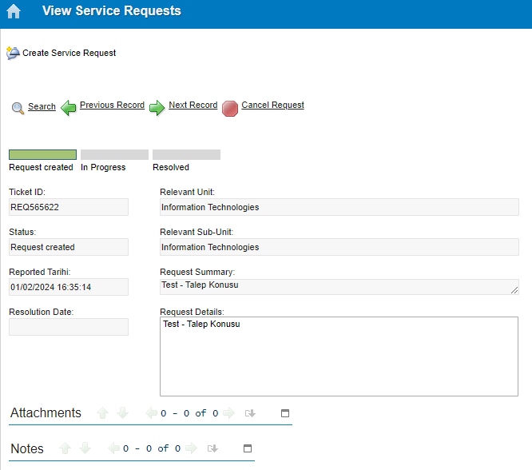
Viewing Service Requests
On View Service Requests page;
You can view your requests by using Previous Record and Nex Record.
You can cancel your request by clicking on Cancel Request.
You can view the status of your request in Status section.
If your request is resolved, you can view the details.
You can add new files regarding your request from Attachments section.
In Notes section, you can add notes regarding your request or view the added notes.

Slide 6
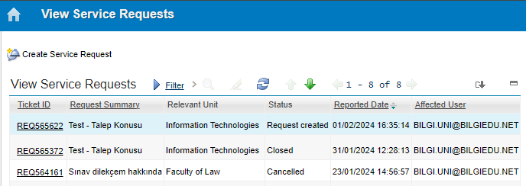
Viewing Request List
By clicking on ‘View Service Requests’ on home page, you can do the following:
You can view the status of your previous requests,
You can view the details by clicking on Request No link.
You can filter the requests by clicking on Filter.
You can list your requests by clicking on relevant column titles.
(By clicking on Create Service Request on the same page, you can create your request without opening the New Request page)

Slide 7
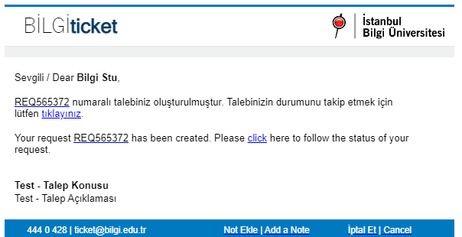
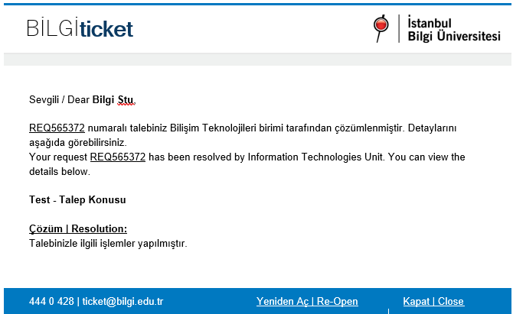
Email Notifications about the Requests
When a new request is created on your behalf by another user, when your request is resolved or canceled, you will receive a notification to your BİLGİ e-mail address as shown on the left.
You can view your request by clicking on the link.
You can add a new note regarding your request by clicking on Add a Note button below or cancel your request by clicking on Cancel button.
If your request is resolved, you can view the details in the e-mail.
If you find the resolution insufficient, you can click the Re-Open button and reactivate your request or
If the request is resolved satisfactorily, you can close it by clicking on Cancel button.
(Unclosed resolved requests are automatically closed after 2 days.)

Slide 8
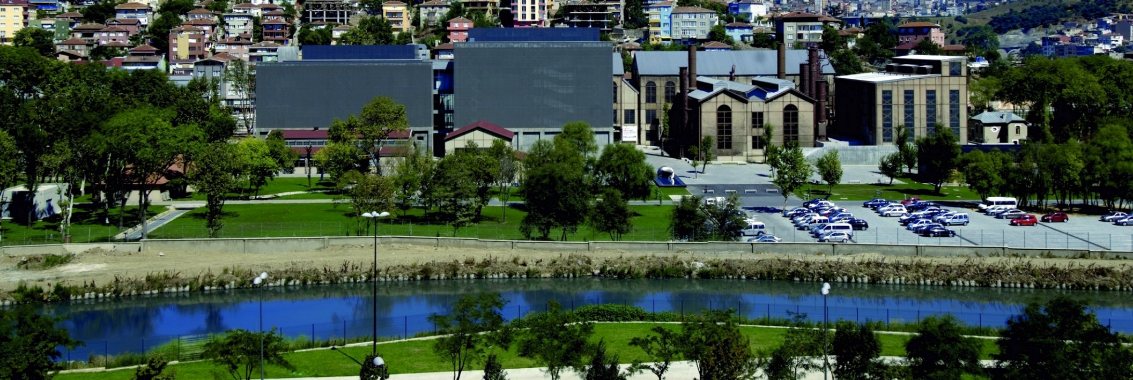
Thank you..

